Slide 1
Reinforcement Learning

Slide 2
Notes:
Many different fields are studying the same problem or elements of the same problem under different names and with different perspectives.
Neuroscience
Reward System
Provides the initial premise for studying reinforcement learning
A dopamine reward system in the brain influences how the brain makes decisions
Psychology
Studies how animals make decisions and what drives animal behavior through experiments in “Classical conditioning”
If you give an animal a reward and the animal starts to salivate
The underlying theory is reinforcement learning.
Engineering
Optimal Control
How to optimally decide a set of actions in order to get the best results
Same problems and methods under a different name.
Economics
Reinforcement learning is a part of game theory
Studies how and why people make decisions if they are trying to maximize their rewards from an economic perspective.

Slide 3
The Problem
The science of decision making
Notes:
Reinforcement learning is something of interest in many different areas.
This is because the problem we are trying to understand is the science of decision making.

Slide 4
“Wherefore, the Lord God gave unto man that he should act for himself. Wherefore, man could not act for himself save it should be that he was enticed by the one or the other.”
2 Nephi 2: 16

Slide 5
What do you need to make decisions?
Notes:
What are the fundamental pieces you use to make everyday decisions?

Slide 6
Characteristics of Reinforcement Learning
There is no supervisor, only a reward signal
Feedback is delayed, not instantaneous
Time really matters (sequential, not independent data)
Agent’s actions determine the subsequent data it receives

Slide 7
Problem Formulation

Slide 8
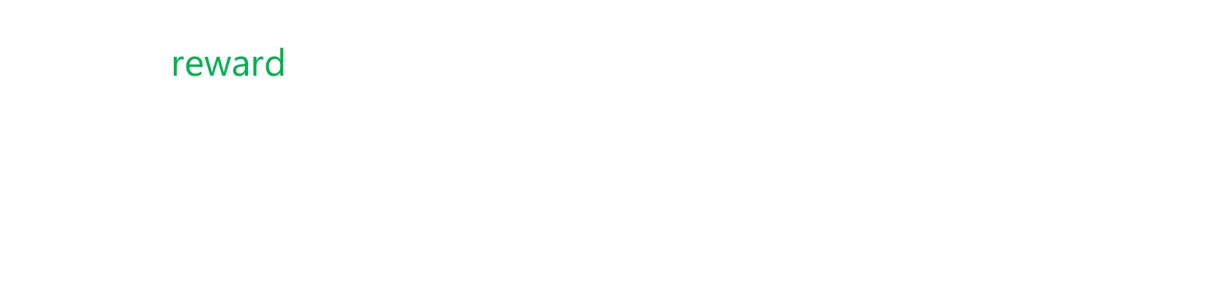
Rewards
A reward $R_{t}$ is a scalar feedback signal
Indicates how well agent is doing at step $t$
The agent’s job is to maximize cumulative reward
Reinforcement learning is based on the reward hypothesis
Definition (Reward Hypothesis)
All goals can be described by the maximization of expected cumulative reward

Slide 9
Examples of Rewards
Fly stunt maneuvers in a helicopter
Positive reward for following desired trajectory
Negative reward for crashing
Defeat the world champion at Backgammon
Positive reward for winning – negative for losing
Manage an investment portfolio
Positive/negative for each $ in the bank
Make a humanoid robot walk
Positive reward for forward motion
Negative reward for falling over

Slide 10
Sequential Decision Making
Goal: Select actions to maximize future reward
Actions may have long term consequences
Reward may be delayed
It may be better to sacrifice immediate reward to gain more long-term reward

Slide 11
Agent and Environment

Slide 12

At each step $t$ the agent:
Executes action $A_{t}$
Receives observation $O_{t}$
Receives scalar reward $R_{t}$
The environment:
Receives action $A_{t}$
Emits observation $O_{t}$
Emits scalar reward $R_{t}$

Slide 13
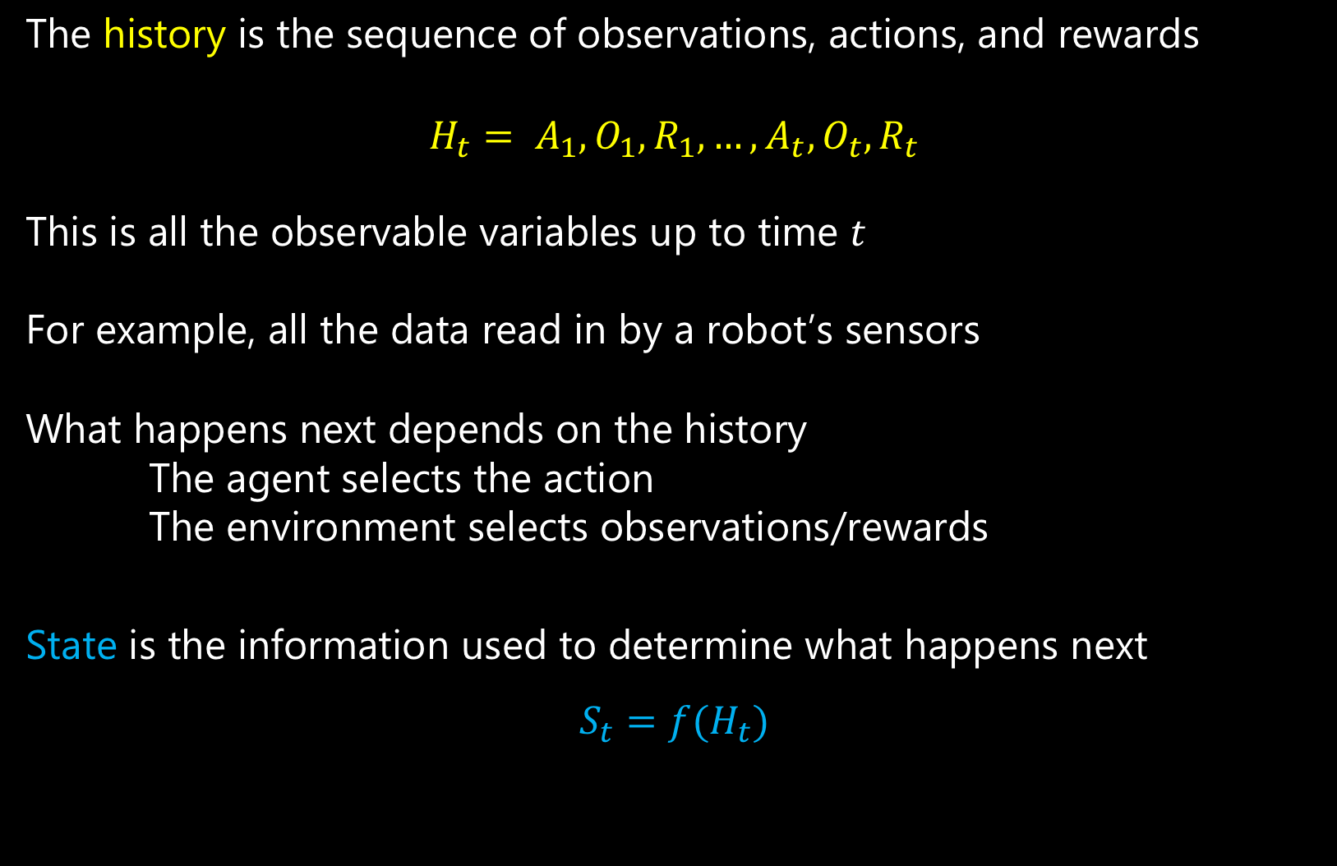
History and State
The history is the sequence of observations, actions, and rewards
$$H_{t}= A_{1}, O_{1}, R_{1},…,A_{t}, O_{t}, R_{t}$$
This is all the observable variables up to time $t$
For example, all the data read in by a robot’s sensors
What happens next depends on the history
The agent selects the action
The environment selects observations/rewards
State is the information used to determine what happens next
$$S_{t}=f(H_{t})$$

Slide 14
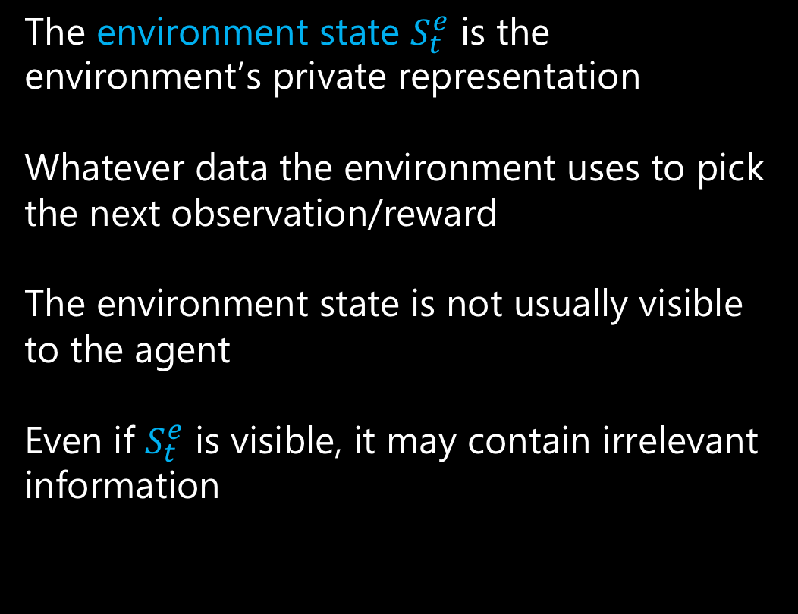
Environment State
The environment state $S_{t}^{e}$ is the environment’s private representation
Whatever data the environment uses to pick the next observation/reward
The environment state is not usually visible to the agent
Even if $S_{t}^{e}$ is visible, it may contain irrelevant information

Slide 15
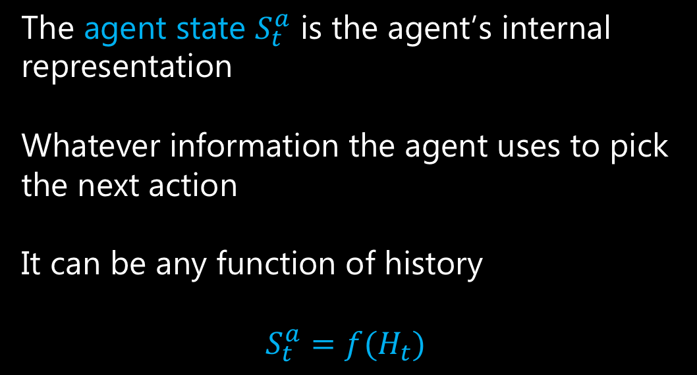
Agent State
The agent state $S_{t}^{a}$ is the agent’s internal representation
Whatever information the agent uses to pick the next action
It can be any function of history
$S_{t}^{a}=f(H_{t})$

Slide 16

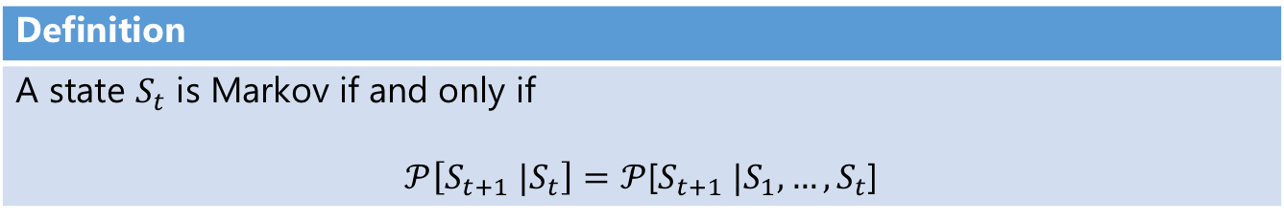
Information State
An information state (A.K.A. Markov state) contains all the useful information from the history.
Definition
A state $S_{t}$ is Markov if and only if $𝒫\left[S_{t+1} |S_{t}\right]=𝒫$[$S_{t+1} |S_{1},…,S_{t}$]
“The future is independent of the past given the present.”
$H_{1:t} →$ $S_{t}$ $→$ $H_{t+1:∞}$
Once the state is known, the history may be thrown away.

Slide 17
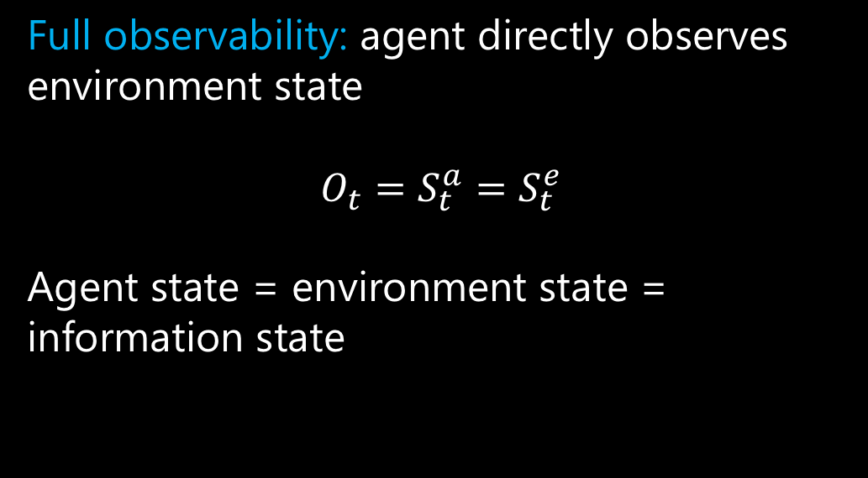
Fully Observable Environments
Full observability: agent directly observes environment state
$$O_{t}=S_{t}^{a}=S_{t}^{e}$$
Agent state = environment state = information state

Slide 18
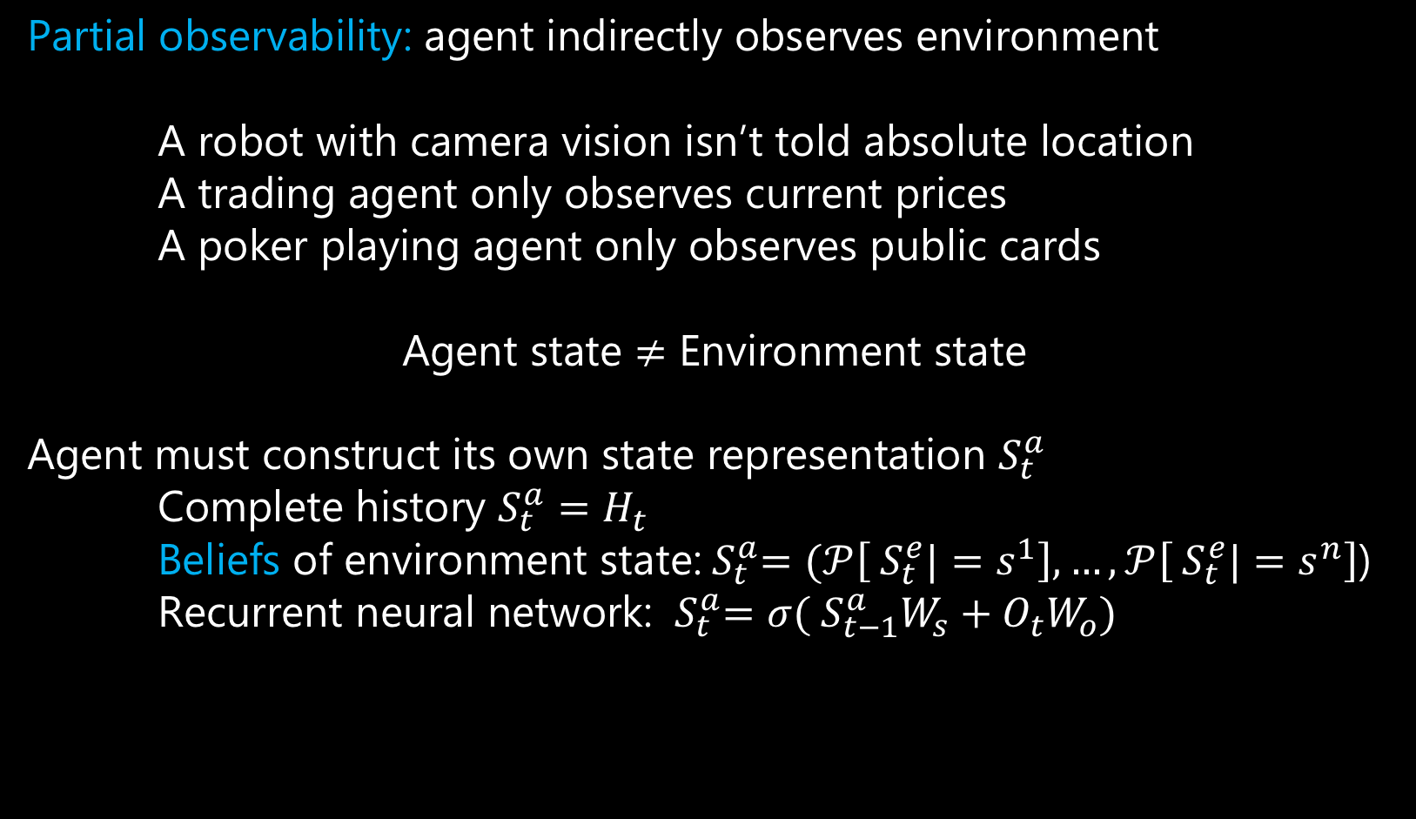
Partially Observable Environments
Partial observability: agent indirectly observes environment
A robot with camera vision isn’t told absolute location
A trading agent only observes current prices
A poker playing agent only observes public cards
Agent state $≠$ Environment state
Agent must construct its own state representation $S_{t}^{a}$
Complete history $S_{t}^{a}=H_{t}$
Beliefs of environment state:${ S}_{t}^{a}=(𝒫\left[{ S}_{t}^{e}|=s^{1}\right],…, 𝒫\left[{ S}_{t}^{e}|=s^{n}\right]$)
Recurrent neural network: ${ S}_{t}^{a}=σ({ S}_{t−1}^{a}W_{s}+O_{t}W_{o})$

Slide 19
The Algorithm

Slide 20
An RL agent may include one or more of these components:
Policy
Value function
Model

Slide 21
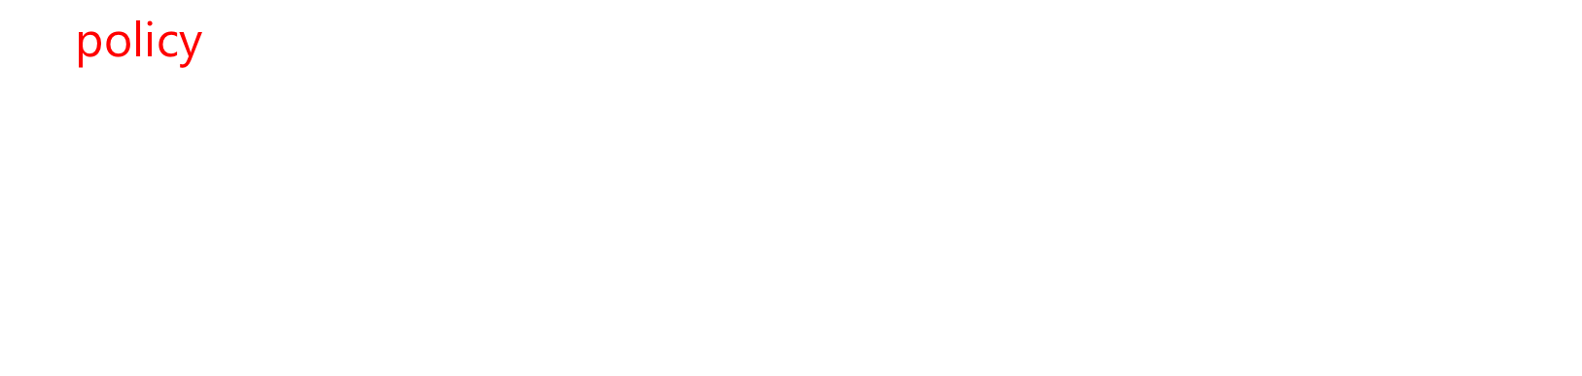
Policy
A policy is the agent’s behavior
A map from state to action
Deterministic policy: $a= π\left(s\right)$
Stochastic policy: $π\left(a|s\right)=𝒫[A=a|S=s]$

Slide 22
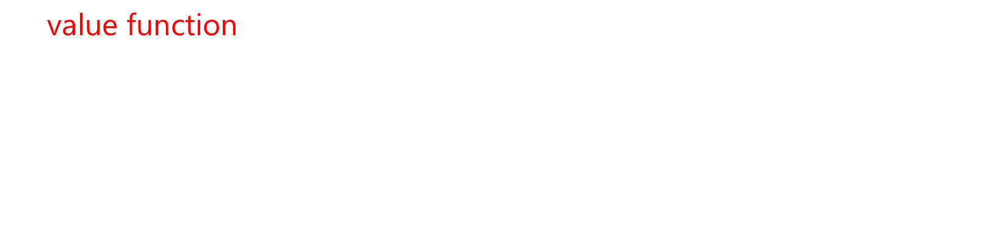
Value Function
A value function is a prediction of future reward
Used to evaluate the goodness/badness of states
Can therefore be used to select between actions
$$v_{π}= 𝔼[R_{t}+γR_{t+1}+γ^{2}R_{t+2}+ …|{ S}_{t}=s]$$

Slide 23
Model
A model predicts what the environment will do next
Used to predict the next state and the next reward

Slide 24
Arrows represent the policy for each state

Slide 25
Numbers represent the value for each state

Slide 26
Problems with Reinforcement Learning

Slide 27
Exploration vs Exploitation
Exploration finds more information about the environment
Exploitation exploits known information about the environment in order to maximize reward
It is usually important to do both
For example, restaurant selection

Slide 28
Prediction vs Control
Prediction: Given a policy, evaluate the future
Control: Find the optimal policy

Slide 29
Examples of Reinforcement Learning

